Slide 1
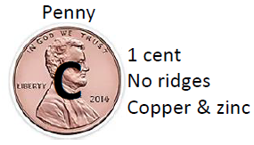
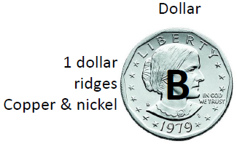
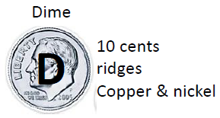
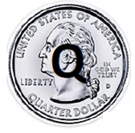
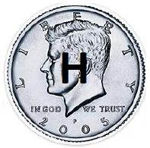
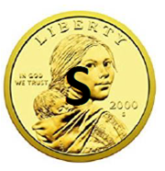
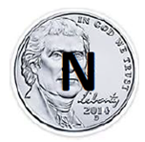
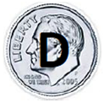
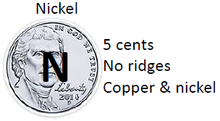
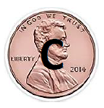
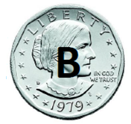
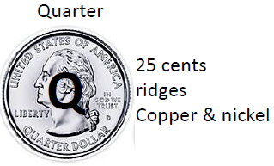
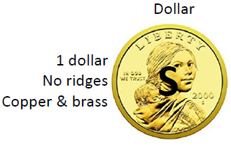
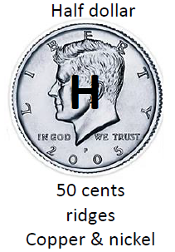
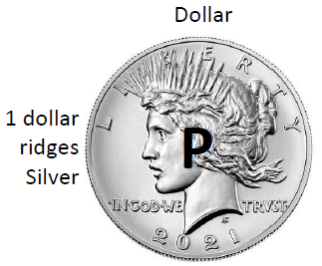
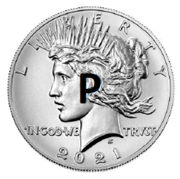
DICHOTOMOUS KEY FOR THE COINS
CHARACTER | COINS | GO TO? | ID
1A:
1B:
2A:
2B:
3A:
3B:
4A:
4B:
5A:
5B:
6A:
6B:
7A:
7B:
8A:
8B:
9A:
9B:
10A:
10B:
NOT SILVER vs. SILVER
Do the NOT SILVER coins first
< 0.50 cent piece vs. > 0.50 cent piece
“Liberty” above vs “Liberty” below
Do the SILVER coins next
Ridges on side vs. NO ridges on side
NOT silver
C,S
Go to #2
-----
Small coin (< 1 in.) vs Large coin (> 1 in.)
silver
N,D,Q,H,B,P
Go to #3
-----
Brown
C
KEYED OUT
C
Gold
S
KEYED OUT
S
Male on front
N,D,Q,H
Go to #4
-----
Female on front
B,P
Go to #5
-----
Ridges on side
D,Q,H
Go to #6
-----
DONE,
ALL COINS KEYED OUT!
NO ridges on side
N
KEYED OUT
N
<0.50 cent piece
B
KEYED OUT
B
>0.50 cent piece
P
KEYED OUT
P
“Liberty” above
D,H
Go to #7
-----
“Liberty” below
Q
KEYED OUT
Q
Small coin (<1 in.)
D
KEYED OUT
D
Large coin (>1 in.)
H
KEYED OUT
H
How can we group these coins using different characteristics such as size, color, metal, etc.?

